Slide 1
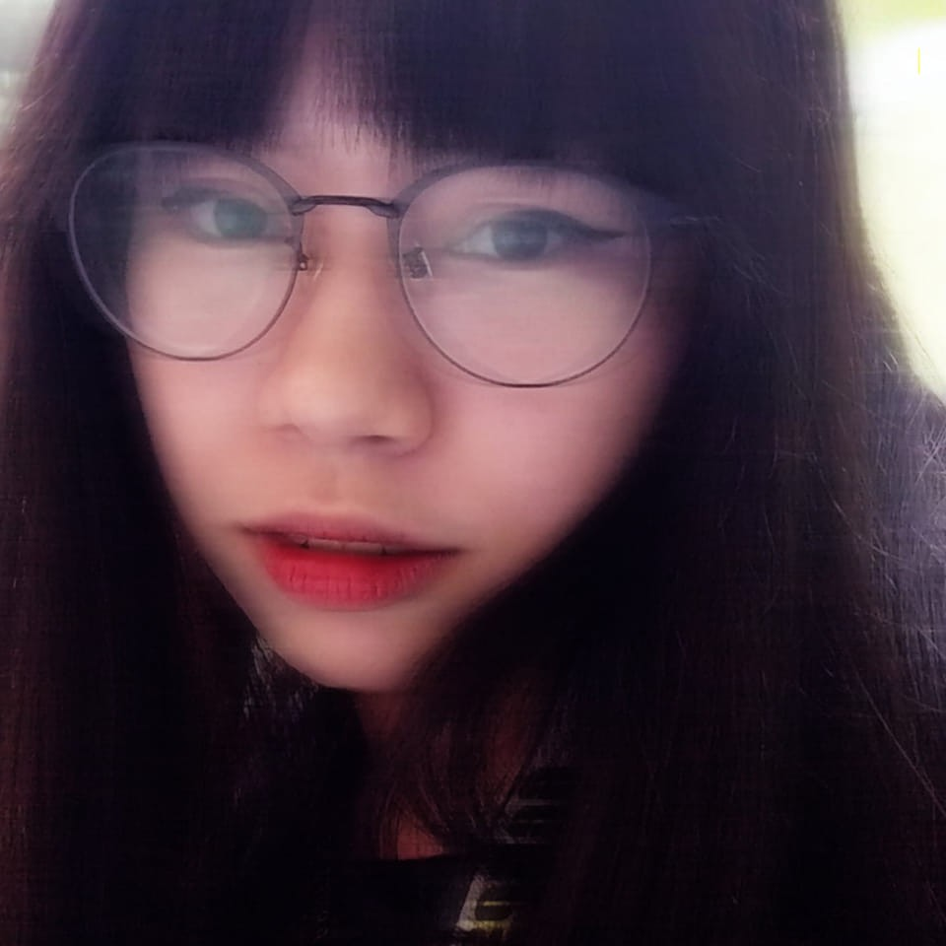


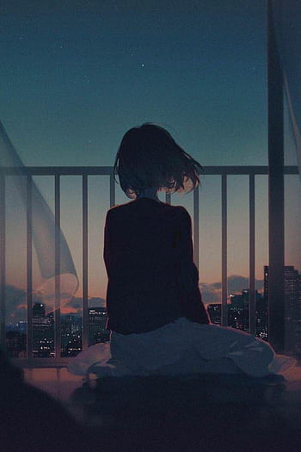




My name is Clarisse Justine D. Crisostomo
Born on April 6th 2000
I currently live in Abucay Bataan.
“I am Qiqi. I am a zombie. And I forgot what comes next.” – Qiqi
Clarisse Justine D. Crisostomo

Slide 2

Clarisse Justine D. Crisostomo
My name is Clarisse Justine D. Crisostomo
Born on April 6th 2000
I currently live in Abucay Bataan.
“I am Qiqi. I am a zombie. And I forgot what comes next.” – Qiqi

Slide 3

Clarisse Justine D. Crisostomo

